Slide 1
Layered Security-Gradient Boosting meets Naive Bayes for Intrusion Detection
6th Congress on Intelligent Systems
(CIS 2025)
September 6-7, 2025
Paper ID : 670
K. Srinivasa Chakravarthy
Dr. G. Shyama Chandra Prasad
V. Krishna Sai Srinivas
Piyush Bhuyan

Slide 2
INTRODUCTION
The report addresses the limitations of existing Intrusion Detection Systems (IDS) in detecting complex and rare attack types, proposing an enhanced Double-Layered Hybrid Approach (DLHA) that replaces SVM with Gradient Boosting algorithms like XGBoost.
It reviews literature on modular IDS architectures, deep learning-based systems, and hybrid approaches, highlighting their strengths and limitations, while emphasizing the need for scalable, accurate, and adaptive frameworks.
The proposed methodology integrates GANs for rare class augmentation, uses Naive Bayes for frequent attacks in Layer 1, and employs XGBoost for rare attacks in Layer 2, ensuring improved detection rates, reduced false alarms, and better adaptability to evolving threats.

Slide 3
MOTIVATION
Timely detection of cyberattacks remains a major research challenge, as legacy systems struggle to address advanced methods like R2L and U2R, which closely mimic normal traffic patterns and pose significant threats to critical sectors like healthcare, finance, and the military.
Support Vector Machines (SVM), while commonly used in IDS frameworks, are computationally expensive, require precise hyperparameter tuning, and perform poorly on imbalanced datasets, making them less effective for detecting rare attacks in real-time scenarios.
Gradient Boosting algorithms, such as XGBoost and LightGBM, offer a superior alternative by improving accuracy, efficiently handling class imbalances, and providing explainability through feature importance, making them ideal for building scalable and robust IDS frameworks to detect rare and complex attack types.

Slide 4
DATASET DESCRIPTION
The NSL-KDD dataset is an improved version of KDD99, removing redundant records and balancing classes. It includes attack types like DoS, Probe, R2L, U2R, and normal traffic for better intrusion detection evaluation.
The KDD-Train dataset has total of 125973 entries. Among those, the majority classes are Normal, DoS and the minority classes are R2L, U2R.
Denial of Service (DoS) – Overwhelms systems with traffic to make them unavailable
Probe – Gathers information about systems through scanning.
Remote-to-Local (R2L) – Gains unauthorized local access from a remote location.
User-to-Root (U2R) – Elevates privileges from a normal user to root access.
Normal – Represents regular, legitimate network traffic with no malicious activity.

Slide 5
DATASET DESCRIPTION
The dataset’s features are grouped into categories to better understand how network behavior and potential threats are analyzed.
1. Basic Connection Features
These features describe the fundamental details of the network connection, such as its protocol, service type, and basic packet information. For example, protocol_type can be tcp or udp, service can be http or ftp, and flag can be SF or S0.
2. Content Features
These features capture suspicious behaviors by analyzing the content of the connection, like login attempts or unusual commands executed. For instance, num_failed_logins may be 0 or 3, root_shell may be 0 or 1, and num_file_creations can be 2 or 5.

Slide 6
DATASET DESCRIPTION
3. Traffic Features (Based on Time Window)
These features describe patterns in traffic volume and error rates over a specific time period, helping detect anomalies. For example, count may be 5 or 20, srv_count may be 10 or 50, and serror_rate can be 0.0 or 0.33.
4. Host-Based Traffic Features
These describe the behavior and interaction patterns of the destination host, such as traffic counts, error rates, and connection similarities. For instance, dst_host_count may be 255 or 100, dst_host_srv_count may be 200 or 50, and dst_host_same_srv_rate can be 1.0 or 0.5.

Slide 7
LIMITATIONS
While DLHA performed well for common attacks like DoS and Probe, it faced challenges with rare attacks such as R2L and U2R, resulting in higher false negative rates due to severe class imbalance in the training dataset.
The lack of advanced post-processing filter algorithms contributed to a high False Alarm Rate (FAR), negatively impacting the overall system performance.
Future enhancements could involve data augmentation techniques to address class imbalance and integrate spam-filtering mechanisms to reduce FAR, thereby improving the system's robustness and scalability for real-world scenarios.

Slide 8
OBJECTIVES
Improve the detection of rare attack types such as U2R and R2L using advanced techniques.
Augment the existing KDD dataset by generating additional samples to enhance training for better attack recognition.
Reduce computational overhead by optimizing algorithms, making attack detection faster and more efficient in resource usage.

Slide 9
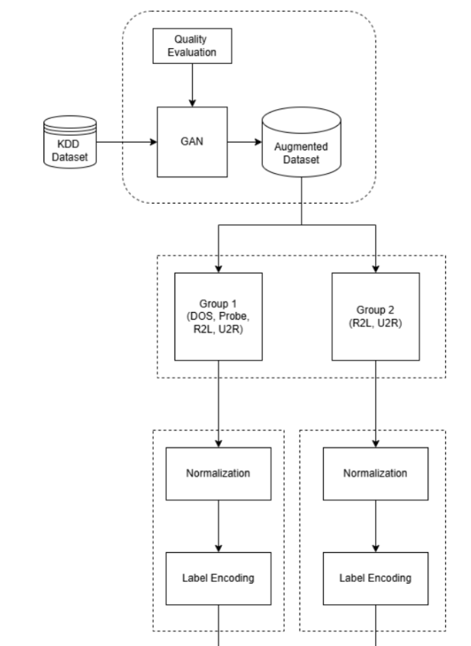
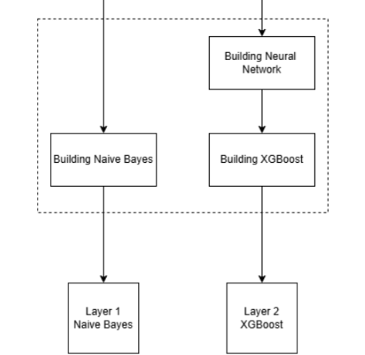
SYSTEM ARCHITECTURE DIAGRAM
Data
Augmentation
Training
and
Validation
Data
Preparation
Data
Transformation

Slide 10
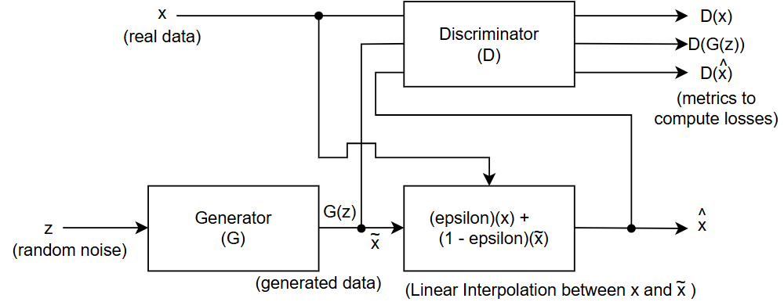
W-GAN ARCHITECTURE DIAGRAM

Slide 11
EXPLANATION
A GAN (Generative Adversarial Network) is a model where the generator creates fake data from random noise, and the discriminator evaluates whether the data is real or artificially generated.
Vanilla GAN failed because severe class imbalance caused mode collapse, with the generator producing mostly common samples and ignoring rare attack types during training.
Conditional GAN failed as adversarial instability remained; rare classes had too few examples, leading to weak convergence and mode collapse within conditioned categories.

Slide 12
EXPLANATION
The main difference between a simple GAN and a Wasserstein GAN (WGAN) is that WGAN uses a continuous scoring critic instead of a binary discriminator, providing smoother gradients and more stable training, especially when real and generated distributions are far apart or imbalanced.
Wasserstein GAN reduced collapse by providing smoother gradients and feedback, but weight clipping required delicate tuning and could destabilize learning if not carefully managed.
WGAN with gradient penalty succeeded by enforcing Lipschitz constraints without clipping, improving stability and allowing robust learning even with extremely scarce examples per attack class.

Slide 13
EVALUATION METRICS
Accuracy = (TP + TN) / (TP + TN + FP + FN)
Recall = (TP) / (TP + FN)
Precision = (TP) / (TP + FP)
F1score = (2 * Precision * Recall) / (Precision + Recall)
False Alarm Rate = (FP) / (FP + TN)
Where,
TP = True Positive FP = False Positive
TN = True Negative FN = False Negative

Slide 14
RESULTS
Distribution of Classes in Original KDDTrain+
Category | Class | Samples | Percentage
Frequent | DoS | 45927 | 37.34
Frequent | Probe | 11656 | 9.47
Rare | R2L | 995 | 0.8
Rare | U2R | 52 | 0.00042
Normal | Normal | 67343 | 54.76
Distribution of Classes in Enhanced KDDTrain+
Category | Class | Samples | Percentage
Frequent | DoS | 65930 | 24.77
Frequent | Probe | 11656 | 4.40
Rare | R2L | 81003 | 30.45
Rare | U2R | 40053 | 15.06
Normal | Normal | 67343 | 25.32

Slide 15
RESULTS
Overall Model Performance on KDDTest+ (in percentage - %)
Model | Accuracy | F1 Score | Precision | Recall | FAR
Original DLHA(NB+SVM) | 85.09 | 79.98 | 76.08 | 85.09 | 1.33
Decision Tree | 85.66 | 81.64 | 87.45 | 85.66 | 1.07
Random Forest | 86.71 | 81.61 | 82.52 | 86.71 | 1.18
Single-layer XG Boost | 86.08 | 80.92 | 76.70 | 86.08 | 1.29
Proposed DLHA (ours) | 85.38 | 80.20 | 76.29 | 85.38 | 1.32

Slide 16
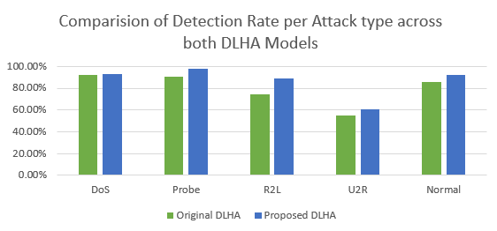
ANALYSIS
Class | Original DLHA | Proposed DLHA
DoS | 92.4% | 92.60%
Probe | 90.8% | 97.96%
R2L | 74.67% | 89.16%
U2R | 55.0% | 60.42%
Normal | 85.3% | 92.0%

Slide 17
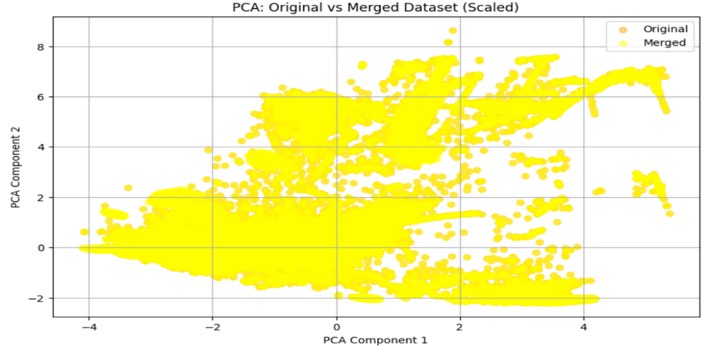
ANALYSIS

Slide 18
CONCLUSION
Enhanced Detection with GANs: Using GAN-based data augmentation significantly improves the detection of rare attacks like R2L and U2R.
Performance Boost with XGBoost: Replacing SVM with XGBoost results in better performance and efficiency in the IDS framework.
Robust Real-World Readiness: The proposed DLHA model outperforms existing systems across all standard metrics and is well-suited for deployment in sensitive environments like cloud infrastructures and defense networks.

Slide 19
FUTURE SCOPE
Smarter and Adaptive Learning: Future enhancements include integrating deep learning models like LSTM/Transformers and enabling real-time (online) learning to improve temporal and adaptive detection capabilities.
Privacy-Preserving Scalability: Deploying the IDS in a federated learning environment to ensure secure, distributed intelligence without compromising data privacy.
Improved Usability and Security: Adding a real-time visualization dashboard for better monitoring and testing the system’s robustness against adversarial attacks for enhanced reliability.

Slide 20
THANK YOU

